Slide 1
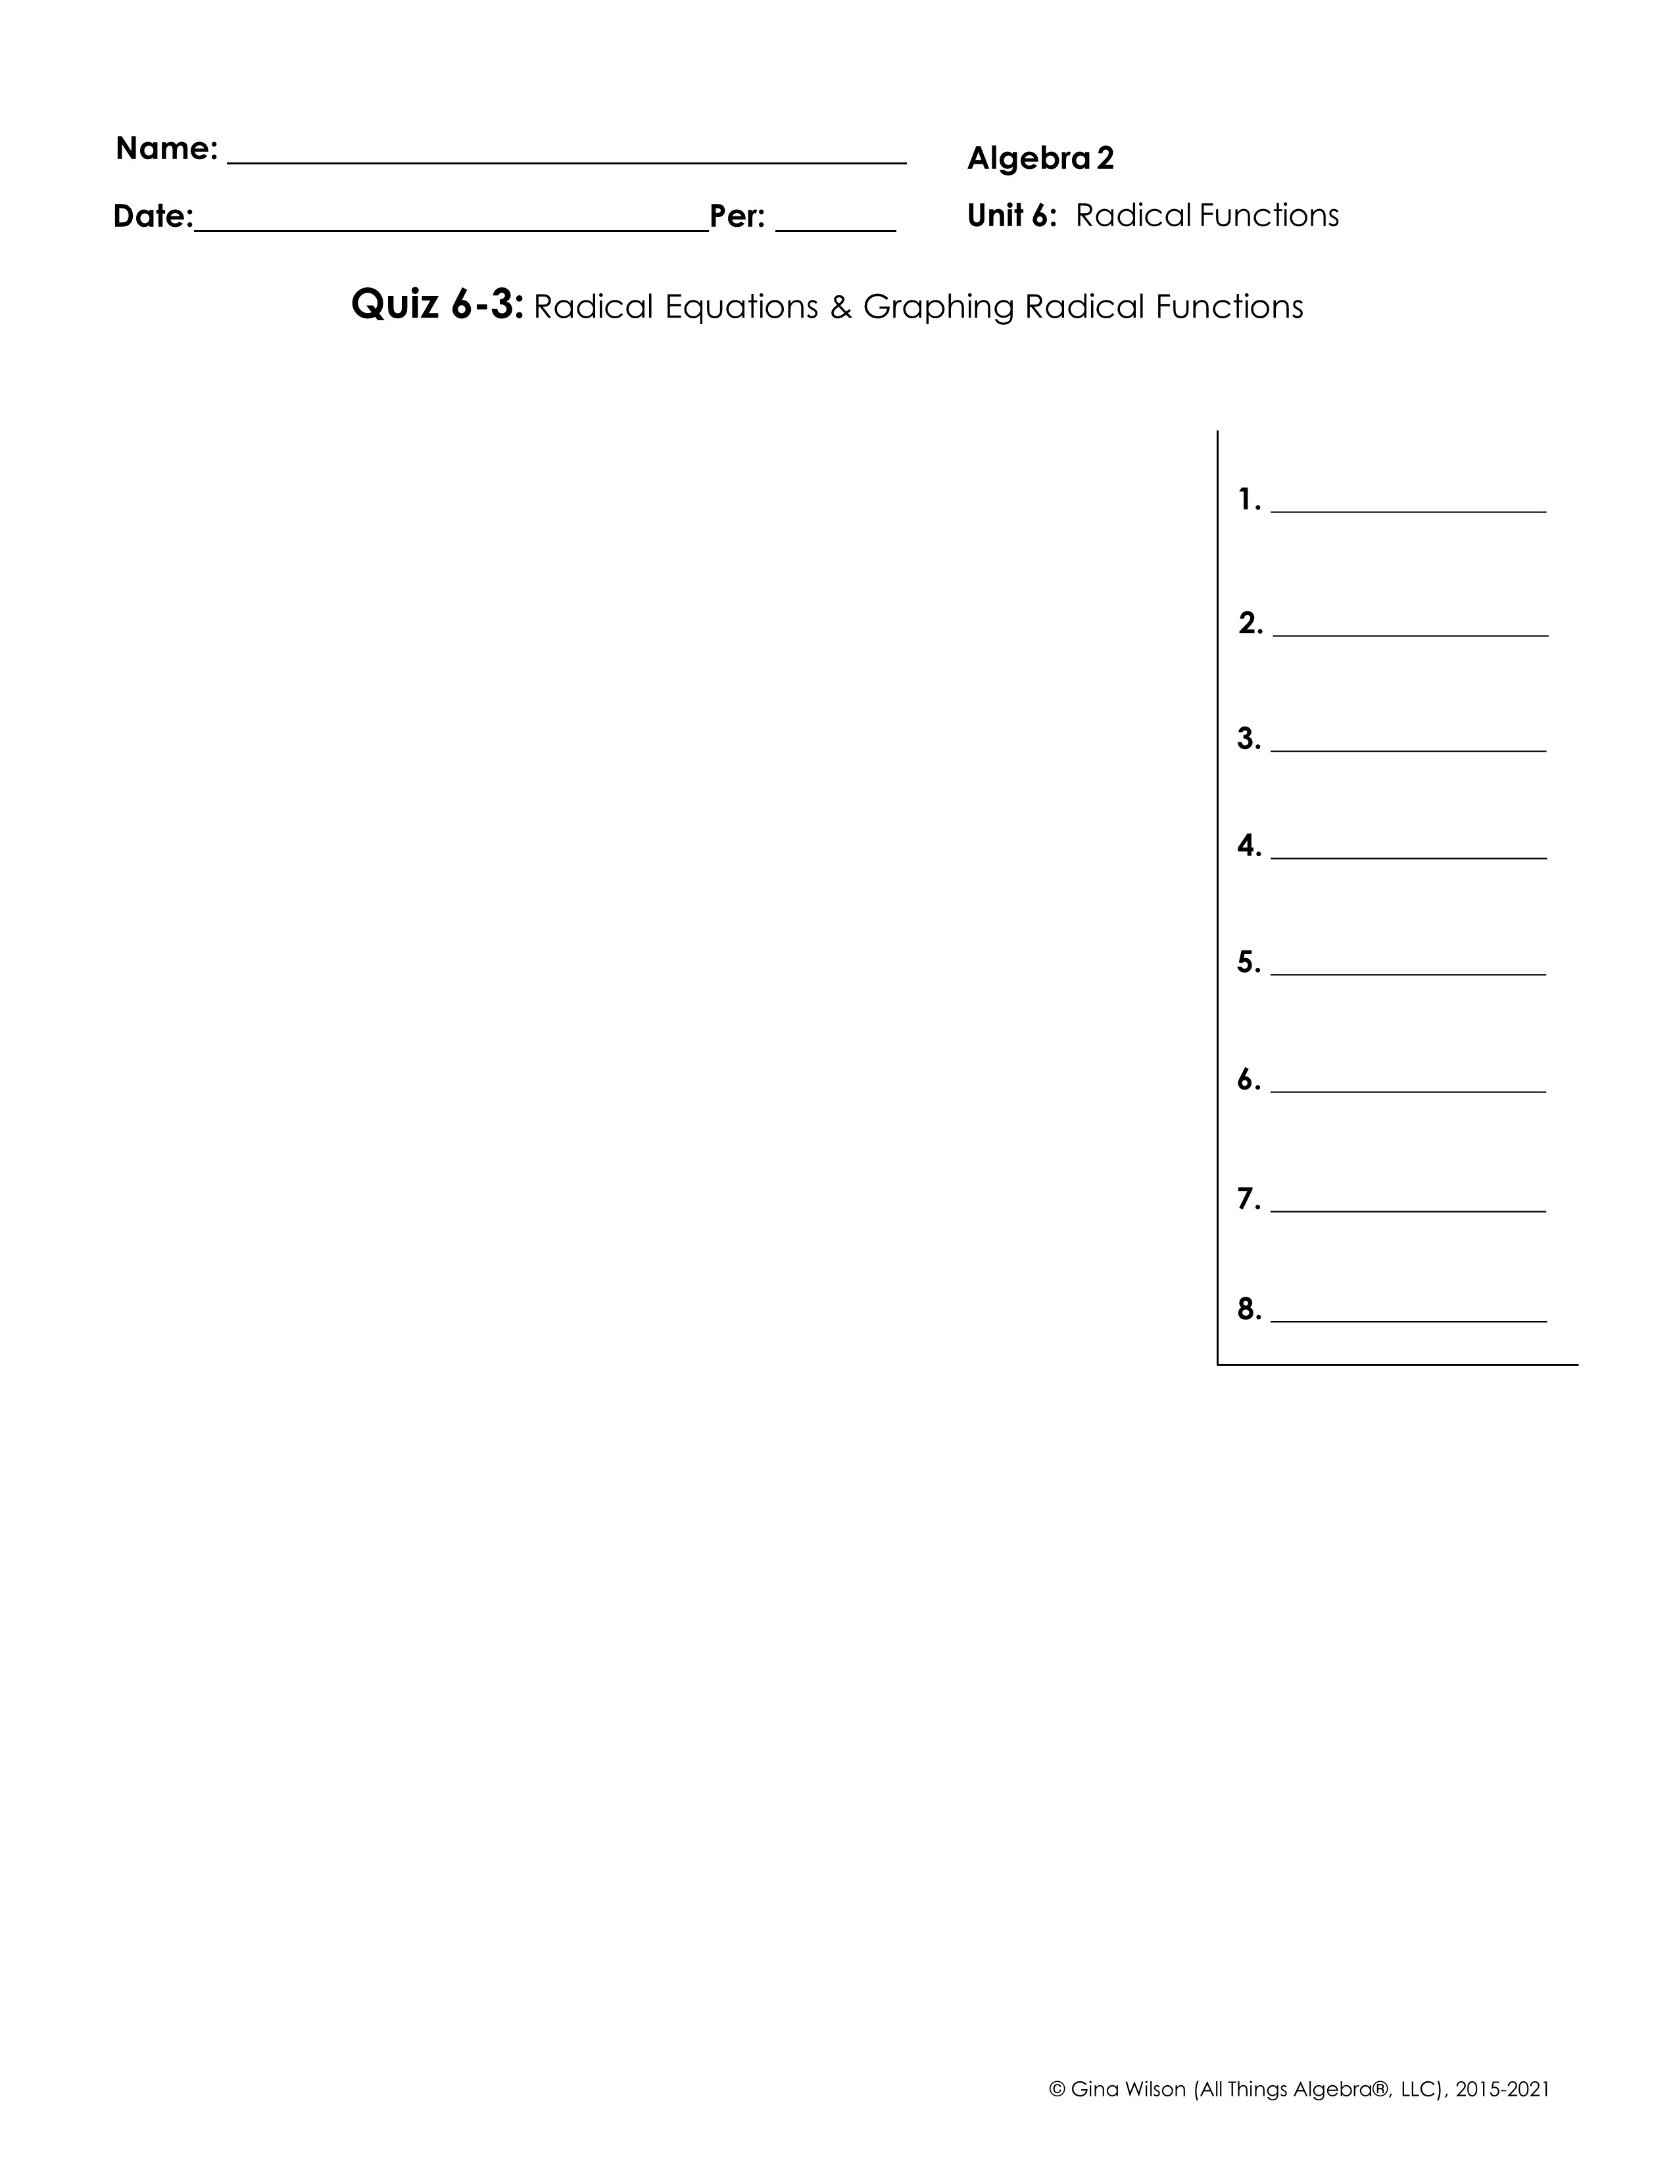
Part I: Radical Equations – Solve each equation. Be sure to check for extraneous solutions.
1.
2.
3.
4.
5.
6.
7.
8.

Slide 2

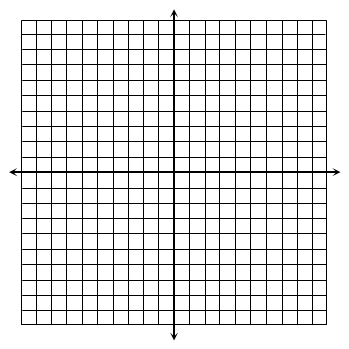
Part II: Graphing – Graph each function and identify its key characteristics.
9.
D: ________________ R: _______________
Endpoint: ____________ End Behavior: As ______, ______ As ______, ______
Increasing Interval(s): _______________ _ Decreasing Interval(s): ______________
10.
D: ________________ R: _______________
Endpoint: ____________ End Behavior: As ______, ______ As ______, ______
Increasing Interval(s): _______________ _ Decreasing Interval(s): ______________
11.
D: ________________ R: _______________
Point of Inflection: ____________ End Behavior: As ______, ______ As ______, ______
Increasing Interval(s): _______________ _ Decreasing Interval(s): ______________
12.
D: ________________ R: _______________
Point of Inflection: ____________ End Behavior: As ______, ______ As ______, ______
Increasing Interval(s): _______________ _ Decreasing Interval(s): ______________

